Slide 1

Intranets and Extranets

Slide 2
UTM – Unified Threat Management
Jack of all trades
It provides multiple functionalities in one device
Firewall, AV, ASPAM, IDS, DLP, VPN
Goals
Simplicity
Streamlined installation and maintenance
Centralized control
Issues
Single point of failure
Single point of compromise
Performance issues
Notes:
How presentation will benefit audience: Adult learners are more interested in a subject if they know how or why it is important to them.
Presenter’s level of expertise in the subject: Briefly state your credentials in this area, or explain why participants should listen to you.

Slide 3
CDN – Content Distribution Networks
Multiple servers distributed across large geographies, each providing content optimized for the users closes to it
a CDN stores a cached version of its content in multiple geographical locations (a.k.a., points of presence, or PoPs).
Each PoP contains a number of caching servers responsible for content delivery to visitors within its proximity.
It helps limit impact from DoS attacks
Notes:
How presentation will benefit audience: Adult learners are more interested in a subject if they know how or why it is important to them.
Presenter’s level of expertise in the subject: Briefly state your credentials in this area, or explain why participants should listen to you.

Slide 4
SDN – Software Defined Networking
Software defined networking (SDN) is an approach to using open protocols, such as OpenFlow, to apply globally aware software control at the edges of the network to access network switches and routers that typically would use closed and proprietary firmware.
SDN Centralizes configuration and control of devices
SDN approach allows traffic to be routed much more efficiently and securely.
Most important element is the abstraction of control and forwarding planes
Notes:
How presentation will benefit audience: Adult learners are more interested in a subject if they know how or why it is important to them.
Presenter’s level of expertise in the subject: Briefly state your credentials in this area, or explain why participants should listen to you.

Slide 5
SDN – Control and Forwarding Planes
Control Plane:
Internetwork routing decisions are made
Responsible for discovering the network topologies and maintain a table of routes for outbound packets
Control plane is implemented in a central node that is responsible for managing all the devices in the network
Forwarding Plane:
Traffic forwarding decisions are made
Forwarding plane is typically implemented in Hardware (ASIC)
Notes:
How presentation will benefit audience: Adult learners are more interested in a subject if they know how or why it is important to them.
Presenter’s level of expertise in the subject: Briefly state your credentials in this area, or explain why participants should listen to you.

Slide 6
SDN – Approaches
Open:
Championed by Open Network Foundation (ONF) and the most common
Relies on open source standards to develop the building blocks of an SDN
Controller communicates with the switches using Open Flow
Open Flow:
it allows the devices implementing forwarding plane to provide information to the controller, while allowing the controller to update the flow table on the devices
Open Flow cannot do deep packet inspection and manipulation
It relies heavily on centralized control plane
Applications communicate with the controller using RESTful or Java API
Notes:
How presentation will benefit audience: Adult learners are more interested in a subject if they know how or why it is important to them.
Presenter’s level of expertise in the subject: Briefly state your credentials in this area, or explain why participants should listen to you.

Slide 7
SDN – Approaches
API:
Championed by CISCO
Leverages rich API on proprietary switches that allows greater control over traffic in SDN
It enriches ONF approach than replacing it
Overlays:
Network nodes are virtualized and treated independent of physical networks upon which this virtualized infrastructure exists.
This SDN exists as a Virtual overlay on top of the physical network
Notes:
How presentation will benefit audience: Adult learners are more interested in a subject if they know how or why it is important to them.
Presenter’s level of expertise in the subject: Briefly state your credentials in this area, or explain why participants should listen to you.

Slide 8
Networks
Intranet:
Private network that is managed by an organization
IP addressing is predominantly internally routable only
Extranet:
Private network between two organizations connected to each other
NATing or routing connections are established
Encrypted tunnel over Internet or WAN would be established
Internet:
Everything that is routed in the external network is considered to be part of Internet
Notes:
How presentation will benefit audience: Adult learners are more interested in a subject if they know how or why it is important to them.
Presenter’s level of expertise in the subject: Briefly state your credentials in this area, or explain why participants should listen to you.

Slide 9
Metropolitan Area Network

Slide 10
MAN
Backbone network connecting LAN to LAN, WAN, Internet and other telecommunication and cable networks
It covers large areas
Majority of MANs are :
SONNET
FDDI
Metro Ethernet
Notes:
How presentation will benefit audience: Adult learners are more interested in a subject if they know how or why it is important to them.
Presenter’s level of expertise in the subject: Briefly state your credentials in this area, or explain why participants should listen to you.

Slide 11
SONET – Synchronous Optical Networks
Standard for telecommunications over fibre optic cables
All SONET lines and rings are fully redundant – “self-heal” – it can use backup redundant ring in case of line breaks
Can transmit voice, video, and data over optical networks
SONET achieves data rate around 50Mbps.
SONET is standard for America, SDH (Synchronous Digital Hierarchy) is standard for rest of the world
Notes:
How presentation will benefit audience: Adult learners are more interested in a subject if they know how or why it is important to them.
Presenter’s level of expertise in the subject: Briefly state your credentials in this area, or explain why participants should listen to you.

Slide 12
Metro Ethernet
Ethernet LANs extend to cover Metropolitan area
Can be used as pure Ethernet or Ethernet integrated with other networking technologies (MPLS)
Pure Ethernet is less expensive but less reliable and scalable
MPLS is more expensive but reliable and scalable
Notes:
How presentation will benefit audience: Adult learners are more interested in a subject if they know how or why it is important to them.
Presenter’s level of expertise in the subject: Briefly state your credentials in this area, or explain why participants should listen to you.

Slide 13
MAN Architecture
Built upon the following layers
Customer Network -> Access Switch -> Service provider Distribution network -> Aggregates the traffic -> Service provider Core Network -> Service provider Distribution network closest to the Destination -> Destination Access Switch -> Destination Network
VPLS (Virtual Private LAN Service) emulates LAN over a managed IP/MPLS network
Notes:
How presentation will benefit audience: Adult learners are more interested in a subject if they know how or why it is important to them.
Presenter’s level of expertise in the subject: Briefly state your credentials in this area, or explain why participants should listen to you.

Slide 14
Wide Area Network

Slide 15
WAN Concepts
WAN provides communication capabilities over a large geographic area
Multiplexing
A method of combining multiple channels of data over a single transmission path
Transmission carrier technologies
Dedicated Links
T-Carriers
E-Carriers
Optical Carrier
ATM
Notes:
How presentation will benefit audience: Adult learners are more interested in a subject if they know how or why it is important to them.
Presenter’s level of expertise in the subject: Briefly state your credentials in this area, or explain why participants should listen to you.

Slide 16
Multiplexing
Statistical Time-Division Multiplexing (STDM)
Transmits several type of data simultaneously over a single transmission line
Analysis statistics related to the typical workload of each input device and determines in real time how much time each device is to be allowed for data transmission
Frequency-division Multiplexing (FDM)
An available wireless spectrum is used to move data
Available frequency band is divided into narrow frequency bands and used to have multiple parallel channels for data transfer
Wave-division Multiplexing (WDM)
Used in Fiber-optic communication
Multiplexes a number of optical carrier signals into a single optical fiber
Notes:
How presentation will benefit audience: Adult learners are more interested in a subject if they know how or why it is important to them.
Presenter’s level of expertise in the subject: Briefly state your credentials in this area, or explain why participants should listen to you.

Slide 17
Dedicated Links
Also called leased line or point-to-point links
One single link that is pre-established for WAN communication between to peers
It is not shared with any other entity
Ideal for situations involving regular, faster and dedicated bandwidth
It is the most expensive
Notes:
How presentation will benefit audience: Adult learners are more interested in a subject if they know how or why it is important to them.
Presenter’s level of expertise in the subject: Briefly state your credentials in this area, or explain why participants should listen to you.

Slide 18
T-Carriers / E-Carriers
Dedicated lines that can carry voice and data over trunk lines
They multiplex several multiple channels into a high speed channel
Works on Time-division multiplexing
Means that each channel gets to use the path only during a specific time slot
T1: Carries 24 voice communication calls over two pairs of copper wire; provided 1.544Mbps transmission rate
T3: Carries 28 T1 lines, with data rate around 50Mbps
E-Carriers are used in European countries; though they are similar to T-Carriers, they are not interoperable.
Notes:
How presentation will benefit audience: Adult learners are more interested in a subject if they know how or why it is important to them.
Presenter’s level of expertise in the subject: Briefly state your credentials in this area, or explain why participants should listen to you.

Slide 19
Optical Carrier
Highspeed fiber-optic connections are measured in Optic Carrier (OC) transmission rate
Small and medium enterprises that require high-speed internet connectivity may use OC-3 (155Mbps) or OC-12 (622Mbps).
Service providers use one or more of OC-48 (2.4Gbps)
OC-192 (9.9Gbps) and greater are used for the internet backbone
Notes:
How presentation will benefit audience: Adult learners are more interested in a subject if they know how or why it is important to them.
Presenter’s level of expertise in the subject: Briefly state your credentials in this area, or explain why participants should listen to you.

Slide 20
WAN Technologies

Slide 21
CSU/DSU
CSU/DSU is required to connect a digital equipment from a LAN to WAN
Provides a digital interface for data terminating equipment (DTE), like router, multiplexer etc and an interface to the data circuit-terminating equipment (DCE) like carrier switch
It basically works as a translator and (at times) line conditioner
Data Service Unit (DSU)
Converts the digital signals (routers, switches) into signals that can be transmitted over the service provider’s digital lines
Ensures the voltage levels are correct and that information is not lost during the conversation
Channel Service Unit (CSU)
CSU connections the network directly to the service provider line
Notes:
How presentation will benefit audience: Adult learners are more interested in a subject if they know how or why it is important to them.
Presenter’s level of expertise in the subject: Briefly state your credentials in this area, or explain why participants should listen to you.

Slide 22
Switching
Two main types of Switching: Packet and Circuit Switching
Circuit Switching:
Sets up a virtual connection that acts like a dedicated link between two systems
More appropriate for voice communications
Example: ISDN and telephone calls
Packet Switching:
Packets from one connection can pass through a number of individual devices instead of the same device
Data is broken into packets containing Frame Check Sequence numbers (FCS)
Variable delays can be noticed in this transmission model
At destination the packets are reassembled using the FCS and processed
More appropriate for data communication
Eg: Internet, X.25, Frame relay
Notes:
How presentation will benefit audience: Adult learners are more interested in a subject if they know how or why it is important to them.
Presenter’s level of expertise in the subject: Briefly state your credentials in this area, or explain why participants should listen to you.

Slide 23
Frame Relay
WAN technology that operates at Data Link Layer
Uses Packet Switching technology
It is a “any-to-any” service shared by multiple users
Two main types are equipment’s are used
DTE – usually customer owned device provides connectivity between company network and frame relay network
DCE – Service provider owned device that does actual data transmission and switching in frame relay cloud
Notes:
How presentation will benefit audience: Adult learners are more interested in a subject if they know how or why it is important to them.
Presenter’s level of expertise in the subject: Briefly state your credentials in this area, or explain why participants should listen to you.

Slide 24
Frame Relay - Virtual Circuits
Frame relay forwards frames across virtual circuits
Permanent Virtual Circuits:
Works like a private line with agreed bandwidth availability
Provides guaranteed bandwidth but does not have flexibility of SVC
Switched Virtual Circuits:
Circuits must be built every time a connection is required
Used for teleconferencing, establishing temporary connections to remote sites, data replication, and voice calls
Once the connection is completed, the circuits are torn down
Notes:
How presentation will benefit audience: Adult learners are more interested in a subject if they know how or why it is important to them.
Presenter’s level of expertise in the subject: Briefly state your credentials in this area, or explain why participants should listen to you.

Slide 25
X.25
It’s a older WAN protocol
Uses Switching technology
It provides “any-to-any” connections
Subscribers are charged based on the amount of bandwidth they use
Data is encapsulated into 128 bytes in HDLC frames. The frames are then addressed and carried across the carrier switches
X.25 provided many layers of error checking, error correcting, and fault tolerance making the protocol fat
Provides lower level of performance than frame relay or ATM
Notes:
How presentation will benefit audience: Adult learners are more interested in a subject if they know how or why it is important to them.
Presenter’s level of expertise in the subject: Briefly state your credentials in this area, or explain why participants should listen to you.

Slide 26
ATM – Asynchronous Transfer Mode
Uses cell-switching method
ATM uses fixed cell size (53 bytes) instead of the variable frame size employed by earlier technologies
This provides better performance and reduced overhead for error handling. Hence is good for voice and video transmissions
It is a connection oriented switching technology, creates and uses a fixed channel
It is used by carriers and service providers, and is the core technology of Internet
The fee is based on the bandwidth consumed
Notes:
How presentation will benefit audience: Adult learners are more interested in a subject if they know how or why it is important to them.
Presenter’s level of expertise in the subject: Briefly state your credentials in this area, or explain why participants should listen to you.

Slide 27
ATM - Quality of Service (QoS)
Capability that allows the protocol to distinguish between different classes to messages and assign priority levels
Allows a service provider to guarantee a level of service to customer
ATM QoS Service Types
Constant Bit Rate (CBR):
Connection oriented
Provides consistent data throughput for time-sensitive applications
Bandwidth requirements are specified during connection setup itself
Variable Bit Rate (VBR):
Connection oriented
Data throughput flow is uneven
Best suited for delay-insensitive applications
Customers specify the peak and average data throughput requirements.
Notes:
How presentation will benefit audience: Adult learners are more interested in a subject if they know how or why it is important to them.
Presenter’s level of expertise in the subject: Briefly state your credentials in this area, or explain why participants should listen to you.

Slide 28
ATM - Quality of Service (QoS)
Unspecified Bit Rate (UBR):
Connectionless channel
Does not promise a specific data throughput rate
Customers cannot, and do not need to, control the traffic rate
Available Bit Rate (ABR):
Connection oriented channel
Allows the bit rate to be adjusted
Customers are given a bandwidth that remains after a guaranteed service rate has been met
Notes:
How presentation will benefit audience: Adult learners are more interested in a subject if they know how or why it is important to them.
Presenter’s level of expertise in the subject: Briefly state your credentials in this area, or explain why participants should listen to you.

Slide 29
ATM - Quality of Service (QoS) Levels
Best-effort service:
No Guarantee of throughput, delay or delivery
Most of the traffic in internet has this classification
Differentiated service:
The traffic has more bandwidth, shorter delays and fewer dropped frames
Guaranteed service:
Ensures specific data throughput at a guaranteed speed
Time-sensitive traffic is assigned this classification.
Notes:
How presentation will benefit audience: Adult learners are more interested in a subject if they know how or why it is important to them.
Presenter’s level of expertise in the subject: Briefly state your credentials in this area, or explain why participants should listen to you.

Slide 30
SDLC – Synchronous Data Link Control
It is a bit-oriented, synchronous protocol
This protocol is used in networks that use dedicated leased lines with permanent physical connections
Used mainly for communications with IBM hosts within a SNA (Systems Network Architecture) – Mainframes to communicate with remote locations
Provides polling media access technology
Notes:
How presentation will benefit audience: Adult learners are more interested in a subject if they know how or why it is important to them.
Presenter’s level of expertise in the subject: Briefly state your credentials in this area, or explain why participants should listen to you.

Slide 31
HDLC – High-level Data Link Control
It is a bit-oriented, link layer protocol
Used for serial device-to-device WAN communication
Extension of SDLC
Bit-oriented protocol
A bit-oriented protocol is a communications protocol that sees the transmitted data as an opaque stream of bits with no semantics, or meaning.
Bit oriented protocol can transfer data frames regardless of frame contents.
Notes:
How presentation will benefit audience: Adult learners are more interested in a subject if they know how or why it is important to them.
Presenter’s level of expertise in the subject: Briefly state your credentials in this area, or explain why participants should listen to you.

Slide 32
PPP – Point-to-Point Protocol
Data link protocol
Carries out framing and encapsulation for Point-to-Point connections
Link Control Protocol (LCP)
Establishes, configures and maintains the connection
Carries out the encapsulation format options, handles varying limits on sizes of packets, detect looped-back link, and terminate link when necessary
Makes sure the foundational functions of the actual connection work properly
Network Control Protocols (NCP)
Used for network layer protocol configuration
Provides user authentication capabilities through PAP, CHAP, EAP
Makes sure that PPP can integrate and work with many different protocols
Notes:
How presentation will benefit audience: Adult learners are more interested in a subject if they know how or why it is important to them.
Presenter’s level of expertise in the subject: Briefly state your credentials in this area, or explain why participants should listen to you.

Slide 33
HSSI – High-Speed Serial Interface
Used to connect multiplexers and routers to high-speed communication services (ATM, Frame Relay)
Supports speeds up to 52Mbps
Works at Physical Layer
Defines the electrical and physical interfaces to be used by DTE/DCE devices.
Notes:
How presentation will benefit audience: Adult learners are more interested in a subject if they know how or why it is important to them.
Presenter’s level of expertise in the subject: Briefly state your credentials in this area, or explain why participants should listen to you.

Slide 34
Multiservice Access Technologies
They combine several type of communication categories over one transmission line
Signalling System 7 Protocol:
Used to set up and tear down public switched telephone network (PSTN) telephone calls
It also performs number translation, local number portability, prepaid billing, and Short Message Service (SMS)
Session Initiation Protocol (SIP):
When VoIP is used it sets up and breaks down the call sessions
It is an application layer protocol
Isochronous Network:
A network that contains necessary protocols and devices that guarantee continuous bandwidth without interruption
Time sensitive applications work on a Isochronous network
Notes:
How presentation will benefit audience: Adult learners are more interested in a subject if they know how or why it is important to them.
Presenter’s level of expertise in the subject: Briefly state your credentials in this area, or explain why participants should listen to you.

Slide 35
VoIP (Voice over IP)
It is a packet-oriented switching technology
It supports voice, data and video
VoIP components:
IP Telephony device:
A phone that has necessary sw that allows it to work as a network device
Voice Mail System:
Storage space for messages, provides user directory lookups and call-forwarding function
Voice Gateway:
Carries our packet routing, provides access to legacy voice systems and backup calling process
Call Processing Manager:
Notifies both sender and receiver that the channel is active.
Notes:
How presentation will benefit audience: Adult learners are more interested in a subject if they know how or why it is important to them.
Presenter’s level of expertise in the subject: Briefly state your credentials in this area, or explain why participants should listen to you.

Slide 36
H.323 Gateway
A standard that deals with video, real-time audio, and data packet-based transmissions where multiple users can be involved with the data exchange
Connects different types of systems and provide necessary translation services
The gateways can translate circuit-oriented traffic into packet-oriented traffic and vice versa
Notes:
How presentation will benefit audience: Adult learners are more interested in a subject if they know how or why it is important to them.
Presenter’s level of expertise in the subject: Briefly state your credentials in this area, or explain why participants should listen to you.

Slide 37
SIP – Session Initiation Protocol
Consists of 2 major components
User Agent Client (UAC)
Application that creates the SIP requests for initiating a communication session
They are generally messaging tools and soft-phone applications that are used to place VoIP calls
User Agent Server (UAS)
SIP Server responsible for handling all routing and signalling involved in VoIP
SIP is not used to stream data because its just a signalling protocol
RTP (Real-time Transport Protocol) provides standardized packet format for delivering audio and video over IP networks
Notes:
How presentation will benefit audience: Adult learners are more interested in a subject if they know how or why it is important to them.
Presenter’s level of expertise in the subject: Briefly state your credentials in this area, or explain why participants should listen to you.

Slide 38
RTP - Real-time Transport Protocol
RTP (Real-time Transport Protocol) provides standardized packet format for delivering audio and video over IP networks
It is a session layer protocol
Carries data in media stream format
Is used extensively in VoIP, telephony, video conference, and other multimedia streaming technologies
Provides end-to-end delivery services
It is commonly run over UDP
RTP Control Protocol (RTCP):
It provides out-of-band statistics and control information to provide feedback on QoS levels of individual streaming multimedia sessions.
Notes:
How presentation will benefit audience: Adult learners are more interested in a subject if they know how or why it is important to them.
Presenter’s level of expertise in the subject: Briefly state your credentials in this area, or explain why participants should listen to you.

Slide 39
SIP Architecture
SIP Architecture consists of 3 types of servers
Proxy Server:
Used to relay packets within a network between UAC and UAS
Forwards requests generated by callers to their respective recipients
Used for name mapping, which allows the proxy server to interlink an external SIP system to an internal SIP client.
Registrar Server:
Keeps the centralized record of the updated locations of all the users in the network
Redirect Server:
Allows SIP devices to retain their identities despite change in their Geographic location
Intraorganizational routing enables SIP traffic to be routed within a VoIP network without having being transmitted over the PSTN or external network.
Notes:
How presentation will benefit audience: Adult learners are more interested in a subject if they know how or why it is important to them.
Presenter’s level of expertise in the subject: Briefly state your credentials in this area, or explain why participants should listen to you.

Slide 40
Remote Connectivity
Notes:
How presentation will benefit audience: Adult learners are more interested in a subject if they know how or why it is important to them.
Presenter’s level of expertise in the subject: Briefly state your credentials in this area, or explain why participants should listen to you.

Slide 41
Dial-up connections
Modem:
Modulates an outgoing digital signal into an analog signal and demodulates the incoming analog signal into digital signals
Dial-up uses the facilities of the public switched telephone network (PSTN) to establish a connection to an Internet service provider (ISP) by dialing a telephone number on a conventional telephone line.
Dial-up connections takes place over PPP, which has authentication capabilities
Notes:
How presentation will benefit audience: Adult learners are more interested in a subject if they know how or why it is important to them.
Presenter’s level of expertise in the subject: Briefly state your credentials in this area, or explain why participants should listen to you.

Slide 42
ISDN – Integrated Services Digital Network
It is a set of telecommunications services that can be used over public and private telecommunications networks.
It provides a digital, point-to-point, circuit-switching medium and establishes a circuit between the two communicating devices
Provides two basics services:
Basic Rate Interface
Primary Rate Interface
Notes:
How presentation will benefit audience: Adult learners are more interested in a subject if they know how or why it is important to them.
Presenter’s level of expertise in the subject: Briefly state your credentials in this area, or explain why participants should listen to you.

Slide 43
ISDN – Services
BRI:
Has two B channels for data transfer and 1 D channel that provides call setup, connection management, error control, caller ID etc
D channel is an out-of-band communication link between the local loop equipment and the user’s system
Has bandwidth of around 144Kbps
Used in small offices and home offices
PRI:
Has 23 B Channels and one D Channel
Has total bandwidth of 1.544Mbps
Suitable for companies that require higher bandwidth compared to BRI ISDN
Notes:
How presentation will benefit audience: Adult learners are more interested in a subject if they know how or why it is important to them.
Presenter’s level of expertise in the subject: Briefly state your credentials in this area, or explain why participants should listen to you.

Slide 44
ISDN – Services
Dial-on-demand Routing:
Allows a company to send WAN data over its existing telephone lines and use the public switched telephone networks as a temporary type of WAN link
It is usually used by companies that send out only a small amount of WAN traffic and is much cheaper than a real WAN implementation
The connection activates when it is needed
Broadband ISDN:
This implementation can handle many different types of services simultaneously and is mainly used within telecommunications carrier backbones.
When BISDN is used ATM is commonly employed to encapsulate data at the data link layer into cells, which travel over a SONET network.
Notes:
How presentation will benefit audience: Adult learners are more interested in a subject if they know how or why it is important to them.
Presenter’s level of expertise in the subject: Briefly state your credentials in this area, or explain why participants should listen to you.

Slide 45
DSL – Digital Subscriber Line
High Speed connection technology used to connect home or office to service provider network
It can provide 6 to 20 times higher bandwidth than ISDN
Uses existing phone lines and provides 24hr connection to internet at rates upto 52Mbps
Provides faster transmission rates because it uses all of the available frequencies available on a voice-grade UTP line.
Notes:
How presentation will benefit audience: Adult learners are more interested in a subject if they know how or why it is important to them.
Presenter’s level of expertise in the subject: Briefly state your credentials in this area, or explain why participants should listen to you.

Slide 46
DSL – flavors
Symmetric Services (SDSL):
Traffic flows at the same speed upstream and downstream
Bandwidth ranges between 192Kbps and 1.1 Mbps; used for business applications that require high speeds in both the directions
Asymmetric Services (ADSL):
Downstream speed is much higher than the upstream speed
Upstream speeds are 128Kbps to 384Kbps; downstream speed is 768Kbps
Used by residential users
High-bit-rate DSL (HDSL):
Provides T1 speed without use of repeaters
Requires two twisted pairs of wires
Very High-Data-Rate Digital Subscriber Line (VDSL):
ADSL at much higher rate ~ 13Mbps down and 2Mbps Up
Capable of supporting high bandwidth applications like HDTV, VoIP
Rate Adaptive Digital Subscriber Line (RADSL):
Adjust the transmission speed to match the quality and the length of the line
Notes:
How presentation will benefit audience: Adult learners are more interested in a subject if they know how or why it is important to them.
Presenter’s level of expertise in the subject: Briefly state your credentials in this area, or explain why participants should listen to you.

Slide 47
Cable Modems
Provides high-speed access to internet through existing cable coaxial and fiber lines
Provides upstream and downstream conversions
Providers should comply with Data-over-cable service interface specifications (DOCSIS)
An international telecommunications standard that allows for the addition of high-speed data transfer to an excising cable tv system.
It includes MAC layer security services
Notes:
How presentation will benefit audience: Adult learners are more interested in a subject if they know how or why it is important to them.
Presenter’s level of expertise in the subject: Briefly state your credentials in this area, or explain why participants should listen to you.

Slide 48
PPTP / L2TP
PPTP uses GRE and TCP to encapsulate PPP packets and extend a PPP connection through an IP network
Tunneled PPP Traffic can be authenticated with PAP, CHAP, MS-CHAP or EAP-TLS
PPP payload is encrypted with Microsoft Point-to-Point Encryption (MPPE)
PPTP cannot support multiple connections over one VPN tunnel – hence cannot be used for gateway-to-gateway connections
PPTP relies on PPP for a majority of its security features
L2TP Tunnels PPP Traffic over various network types (IP, ATM, X.25)
L2TP inherits PPP authentication and integrates with IPSec to provide confidentiality, integrity, and potentially another layer of authentication
Notes:
How presentation will benefit audience: Adult learners are more interested in a subject if they know how or why it is important to them.
Presenter’s level of expertise in the subject: Briefly state your credentials in this area, or explain why participants should listen to you.

Slide 49
IPSec
Suit of protocols that was developed to protect IP Traffic
Works at the network layer of the OSI Model
Protocols that make up IPSec are:
Authentication Header (AH): Provides Data integrity, data-origin authentication, and protection against replay attacks
Encapsulating Security Payload (ESP): Provides confidentiality, Data origin authentication and data integrity
ISAKMP: Provides a framework for security association creation and key exchange
IKE: Provides authenticated keying material for use with ISAKMP
Can be configured to provide transport adjacency – more than one security protocol can be used in a VPN tunnel
Can also be configured to provide iterated tunnelling – IPSec tunnel is tunnelled through another IPSec tunnel
Notes:
How presentation will benefit audience: Adult learners are more interested in a subject if they know how or why it is important to them.
Presenter’s level of expertise in the subject: Briefly state your credentials in this area, or explain why participants should listen to you.

Slide 50
TLS - Transport Layer Security VPN
TLS works at the session layer of the network stack and is used mainly to protect HTTP traffic
Common TLS VPN implementations:
TLS Portal VPN:
This type of SSL VPN allows for a single SSL connection to a Web site so the end user can securely access multiple network services.
The site is called a portal because it is one door (a single page) that leads to many other resources.
TLS tunnel VPN:
This type of SSL VPN allows a Web browser to securely access multiple network services, including applications and protocols that are not Web-based, through a tunnel that is running under SSL
SSL tunnel VPNs require that the Web browser be able to handle active content
Notes:
How presentation will benefit audience: Adult learners are more interested in a subject if they know how or why it is important to them.
Presenter’s level of expertise in the subject: Briefly state your credentials in this area, or explain why participants should listen to you.

Slide 51
Authentication Protocols
PAP – Password Authentication Protocol
Used by remote users to authenticate over PPP connections
Provides identification and authentication of the user
Credentials are sent in clear text – Least secure protocol
PAP is vulnerable to sniffing attacks
Challenge Handshake Authentication Protocol (CHAP)
Uses a challenge response mechanism to authenticate a user
CHAP is not vulnerable to man-in-the-middle attacks
Extensible Authentication Protocol (EAP)
Provides a framework to enable many types of authentication techniques to be used when establishing network connections
It extends the authentication possibilities to one-time passwords, token cards, biometrics, Kerberos, digital certificates etc.
Notes:
How presentation will benefit audience: Adult learners are more interested in a subject if they know how or why it is important to them.
Presenter’s level of expertise in the subject: Briefly state your credentials in this area, or explain why participants should listen to you.

Slide 52
Wireless Networks
Notes:
How presentation will benefit audience: Adult learners are more interested in a subject if they know how or why it is important to them.
Presenter’s level of expertise in the subject: Briefly state your credentials in this area, or explain why participants should listen to you.

Slide 53
Wireless Communication Techniques
Frequency:
It dictates the amount of data that can be carried and how far
The higher the frequency, the more data the signal can carry
The higher the frequency, the less the distance it can carry without signal interference
Frequency is measured in Hertz (Hz)
Amplitude
The energy or strength of the signal, operating at a single frequency
Notes:
How presentation will benefit audience: Adult learners are more interested in a subject if they know how or why it is important to them.
Presenter’s level of expertise in the subject: Briefly state your credentials in this area, or explain why participants should listen to you.

Slide 54
Spread Spectrum
Distribution of signals across the allocated frequencies
They are primarily used to reduce the effects of adverse conditions lik crowded radio bands, interference and eavesdropping
Frequency Hopping Spread Spectrum (FHSS):
Takes the total amount of bandwidth and splits into smaller subchannels
Uses only a portion of the bandwidth available at any one time
Sender and receiver works at one of the subchannels for a specific time and move to another subchannel
FHSS algorithm determines the individual frequencies that will be used, in what order ~ hop sequence
If hoping sequence is known the security offered is rendered useless
If signal is corrupted it must be resent
802.11 used FHSS
Notes:
How presentation will benefit audience: Adult learners are more interested in a subject if they know how or why it is important to them.
Presenter’s level of expertise in the subject: Briefly state your credentials in this area, or explain why participants should listen to you.

Slide 55
Spread Spectrum
Direct Sequence Spread Spectrum (DSSS):
It applies sub-bits to a message
Sub-bits (chips) are used by the sending system to generate a different format of the data before it is transmitted
The sequence of how sub-bits are applied is called chipping code
The sender and receiver must be properly synchronized
The sub-bits provide error-recovery instructions ~ the signal can be regenerated using the sub-bits
Sub-bits prevents interference, allows for tracking of multiple transmissions, and provides a level of error correction
It uses all of the available bandwidth continuously
It spreads the signals over a wider frequency band
It has higher data throughput than FHSS
802.11b, 802.15.4 uses DSSS; 802.11g uses both DSSS and OFDM
Notes:
How presentation will benefit audience: Adult learners are more interested in a subject if they know how or why it is important to them.
Presenter’s level of expertise in the subject: Briefly state your credentials in this area, or explain why participants should listen to you.

Slide 56
Orthogonal Frequency division Multiplexing (OFDM)
OFDM is a frequency-division multiplexing (FDM) scheme used as a digital multi-carrier modulation method
It divides a high data rate modulating stream placing them onto many slowly modulated narrowband close-spaced subcarriers, and in this way is less sensitive to frequency selective fading.
It is being used for many of the latest wireless and telecommunications standards.
The modulated signals are orthogonal and do not interfere with each other
It is a multiplexing technology and not a spread spectrum technology
Notes:
How presentation will benefit audience: Adult learners are more interested in a subject if they know how or why it is important to them.
Presenter’s level of expertise in the subject: Briefly state your credentials in this area, or explain why participants should listen to you.

Slide 57
WLAN Components
Access Point:
A link wireless devices use to connect to resources in wired network
Infrastructure WLAN:
AP connects wireless and wired network
Stand-alone WALN:
The AP is not connected to wired network
Ad hoc WLAN:
There are no Aps
Notes:
How presentation will benefit audience: Adult learners are more interested in a subject if they know how or why it is important to them.
Presenter’s level of expertise in the subject: Briefly state your credentials in this area, or explain why participants should listen to you.

Slide 58
802.11 Standard
It was the first WLAN Standard – Wired Equivalent Privacy (WEP)
Wireless devices using this protocol can authenticate to AP in two ways
Open System Authentication (OSA):
does not really provide authentication; only identification using the wireless adapter's MAC address
It is used when no authentication is required
Shared key Authentication (SKA):
Shared key authentication verifies that an authentication-initiating station has knowledge of a shared secret
The 802.11 standard assumes that the shared secret is delivered to the participating wireless clients by means of a secure channel
Notes:
How presentation will benefit audience: Adult learners are more interested in a subject if they know how or why it is important to them.
Presenter’s level of expertise in the subject: Briefly state your credentials in this area, or explain why participants should listen to you.

Slide 59
WEP Flaws
Use of Static Encryption Keys
Uses RC4 algorithm (Stream symmetric cipher)
Hence sender and receiver must have the same key
Update of keys is not mandatory
Ineffective use of Initialization Vector
Same IV values are used over and over again
With the same IV and same shared secret there is no way to provide randomness
Lack of Packet Integrity Assurance
Alteration of Integrity Check Value (ICV) goes undetected resulting in no assurance to integrity of the data
Notes:
How presentation will benefit audience: Adult learners are more interested in a subject if they know how or why it is important to them.
Presenter’s level of expertise in the subject: Briefly state your credentials in this area, or explain why participants should listen to you.

Slide 60
WPA – Wi-Fi Protected Access
WPA employs specific protocols, technologies and algorithms to enhance security
Temporal Key Integrity Protocol (TKIP)
Backward compatible with devices based on WEP
Works with WEP by feeding it key material, generates new key for every frame that is transmitted
Goal is to increase the strength of WEP
It provides sequence counter to protect against replay attacks
Implements message integrity check mechanisms (uses MIC instead of ICV)
WEP also integrates 802.1X port authentication and EAP authentication methods
Notes:
How presentation will benefit audience: Adult learners are more interested in a subject if they know how or why it is important to them.
Presenter’s level of expertise in the subject: Briefly state your credentials in this area, or explain why participants should listen to you.

Slide 61
802.11i – Wi-Fi Protected Access (WPA2)
Provides better protection by the use of AES algorithm in counter mode with CBC-MAC (CCMP)
AES is more appropriate than RC4 and provides higher level of protection
WPA2 defaults to CCMP but can switch down to TKIP and RC4
It does not deal with the full protocol stack; but addresses only on what is taking place in data link layer
It does specify particular authentication protocols
Notes:
How presentation will benefit audience: Adult learners are more interested in a subject if they know how or why it is important to them.
Presenter’s level of expertise in the subject: Briefly state your credentials in this area, or explain why participants should listen to you.

Slide 62
802.1X
802.1X standard is a port-based network access control that ensures a user cannot make a full network connection until he is authenticated
Three main entities in this standard are
Supplicant (Wireless device)
Authenticator (AP)
Authentication Server
It provides the framework that allows different EAP modules to be added
Notes:
How presentation will benefit audience: Adult learners are more interested in a subject if they know how or why it is important to them.
Presenter’s level of expertise in the subject: Briefly state your credentials in this area, or explain why participants should listen to you.

Slide 63
EAP Protocol use
Use of EAP allows different protocols to be used by different vendors
Light weight extensible authentication protocol (LEAP)
Used by Cisco
Purely password based authentication framework
EAP-TLS
Carries out authentication using Digital Certificates
PEAP
Only the servers uses Digital Certificates
EAP-TTLS
EAP protocol that extends TLS
Only server uses digital certificates
Notes:
How presentation will benefit audience: Adult learners are more interested in a subject if they know how or why it is important to them.
Presenter’s level of expertise in the subject: Briefly state your credentials in this area, or explain why participants should listen to you.

Slide 64
Wireless Standards
Standard | Frequency | Transfer Rate | SP type | characteristics
802.11 | 2.4GHz | 2Mbps | FHSS | First WLAN standard; not used now
802.11b | 2.4GHz | 11Mbps | DSSS | Backward compatible with 802.11
802.11a | 5GHz | 54Mbps | OFDM | Not compatible with b and 802.11 Max speed is attained within 25 feet from AP
802.11e |  |  |  | It is an approved amendment to the IEEE 802.11 Defines a set of quality of service (QoS) enhancements
802.11g | 2.4GHz | 54Mbps | OFDM | Backward compatible with 802.11b
802.11n | 2.4GHz or 5GHz | 100Mbps | MIMO | Requires use of two receive and two transmit antennas to broadcast in parallel using 20MHz channel
802.11ac | 5GHz | 1.3Gbps | MIMO | Extension of 802.11n; beamforming: Shaping of radio signals to improve their performance. Able to maintain high data rates over longer ranges
802.16 | 20MHz | 1Gbps | OFDM | MAN wireless standard; WiMAX is based on this
802.15.4 | 2.4GHz | 250kbps |  | Wireless personal area network; deals with a smaller area network, allows local device connectivity (wireless mouse, music player); Key enabler for IoT; ZingBee is the most popular protocol
Notes:
How presentation will benefit audience: Adult learners are more interested in a subject if they know how or why it is important to them.
Presenter’s level of expertise in the subject: Briefly state your credentials in this area, or explain why participants should listen to you.

Slide 65
Satellites
Used to provide connectivity between two locations
The two locations must be within the satellites line of sight and footprint
The ground station modulates the data into a radio signal that is transmitted to the satellite. A transponder on the satellite receives this signal, amplifies it and relays it to the receiver.
Two main microwave wireless transmission
Satellite: Ground to Orbiter to Ground
Terrestrial: Ground to Ground
VSAT: Links a remote office to the Internet through a satellite gateway facility run by a service provider
Notes:
How presentation will benefit audience: Adult learners are more interested in a subject if they know how or why it is important to them.
Presenter’s level of expertise in the subject: Briefly state your credentials in this area, or explain why participants should listen to you.

Slide 66
Mobile Wireless
Frequency Division Multiple Access (FDMA)
Earliest multiple access technology
Available frequency is subdivided into sub-bands and each band is allocated to one subscriber
Subscriber has exclusive rights during the call or till the call is end
Multiple users can share the same frequency without the risk of interference
Was used in 1st Generation mobile networks
Time Division Multiple Access (TDMA)
Divides the radio-frequency spectrum channels into time slots thereby increasing the speed and efficiency of the network
Multiple users can share the same channel at various time periods
In TDMA systems, time is divided into Frames, Frames is divided into slots
Each slots start and end time should be known to both the source and destination
GSM uses TDMA
Code Division Multiple Access (CDMA)
Orthogonal frequency division multiple access (OFDMA)
Notes:
How presentation will benefit audience: Adult learners are more interested in a subject if they know how or why it is important to them.
Presenter’s level of expertise in the subject: Briefly state your credentials in this area, or explain why participants should listen to you.

Slide 67
Mobile Wireless
Code Division Multiple Access (CDMA)
Assigns a unique code each voice or data transmission to identify it from all other transmissions
Calls are spread throughout the entire frequency band
Permits every user of the network to simultaneously use every channel in the network
Also a cell can simultaneously interact with multiple other cells
It is the main technology for mobile carriers in US
Orthogonal frequency division multiple access (OFDMA)
Derived from a combination of TDMA and FDMA.
Each of the channels is subdivided into a set of closely spaced orthogonal frequencies with narrow bandwidths
Each subchannel can be simultaneously transmitted and received in a multiple input, multiple output (MIMO) manner
4G requires OFDMA
4G devices are IP based and does not support circuit-switched telephony service
Notes:
How presentation will benefit audience: Adult learners are more interested in a subject if they know how or why it is important to them.
Presenter’s level of expertise in the subject: Briefly state your credentials in this area, or explain why participants should listen to you.

Slide 68
Network Encryption
Link Encryption
Also called online encryption
Encrypts all data along a specific communication path
Only traffic that is not encrypted is the Data link control messages
It is usually provided by the service providers
Packets must be decrypted and encrypted at each hop
Provides protection against packet sniffers and eavesdroppers
Occurs at Data link and Physical layers
End-to-End Encryption
Only the data is encrypted ~ header, addresses, routing information are not encrypted
Usually user initiated from the originating system
Provides more flexibility for the user to determine the encryption need
Message stays encrypted through the transmission path

Slide 69
Email Encryption Standards
MIME (Multipurpose Internet Mail Extension)
Technical specification indicating how multimedia data and email binary attachments are to be transferred
Secure MIME is a standard for encrypting and digitally signing email and for providing secure data transmissions.
Encryption and Hashing algorithms can be provided by the user
S/MIME follows Public Key cryptographic standards
PGP (Pretty Good Privacy)
Complete cryptosystem to protect emails and files
Can use RSA for key management and IDEA for bulk encryption
It uses passphrases to encrypt user’s private key
It does not use hierarchy of CAs; rather relies on “Web of trust”

Slide 70
Internet Security
HTTP
Stateless protocol
Sits on top of TCP/IP
HTTPS
HTTP over SSL or TLS
SSL (Secure Sockets Layer)
Uses public key encryption and provides data encryption, server authentication, message integrity, and optional client authentication
It requires an SSL enabled server and browser
SSL lies below session and above transport layer

Slide 71
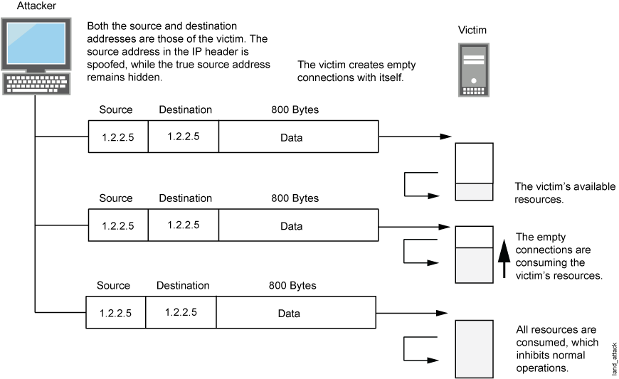
Network Attacks
Ping of Death:
Sending a ping packet larger than 65,535 bytes violates the Internet Protocol, attackers would generally send malformed packets in fragments. When the target system attempts to reassemble the fragments and ends up with an oversized packet, memory overflow could occur and lead to various system problems including crash.
LAND Attack:
Combining a SYN attack with IP spoofing,
a land attack occurs when an attacker sends
spoofed SYN packets containing the IP address
of the victim as both the destination and the
source IP address.

Slide 72
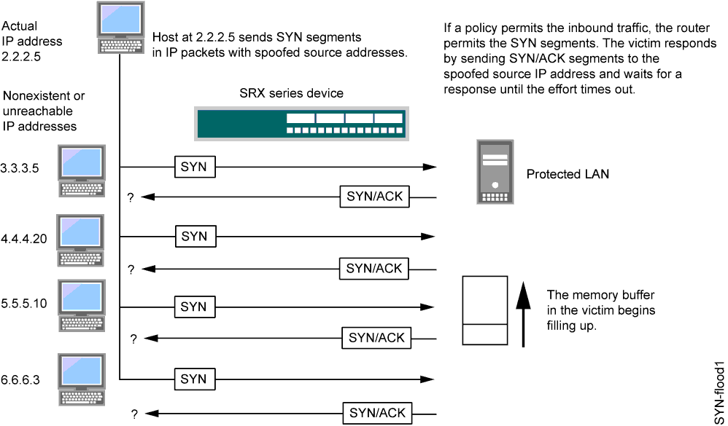
Network Attacks
Syn Flood:
https://www.juniper.net/documentation/en_US/junos12.1x44/topics/concept/denial-of-service-network-syn-flood-attack-understanding.html

Slide 73
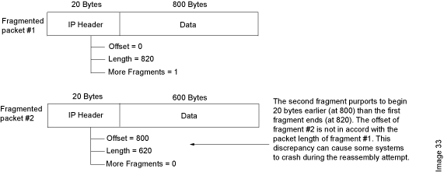
Network Attacks
Tear Drop Attack:
https://www.juniper.net/techpubs/en_US/junos12.1x44/topics/concept/denial-of-service-os-teardrop-attack-understanding.html

Slide 74
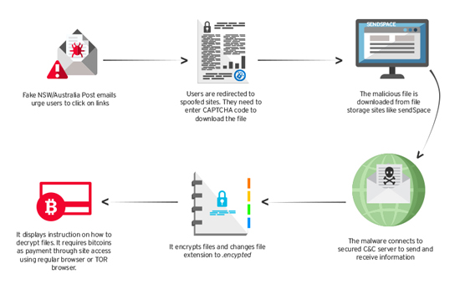
Ransomware Attack
http://blog.trendmicro.com/trendlabs-security-intelligence/torrentlocker-ransomware-hits-anz-region/

Slide 75
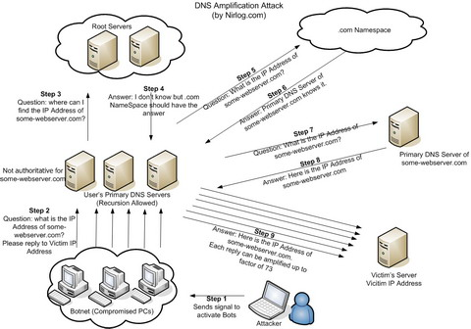
DNS Amplification Attack
http://securitytnt.com/dns-amplification-attack/

Slide 76
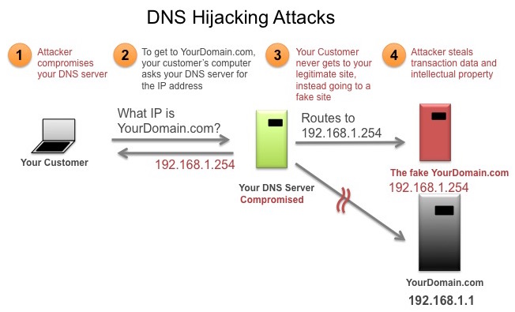
DNS Hijacking
https://mxtoolbox.com/productinfo/dnsmonitoring.aspx

Slide 77
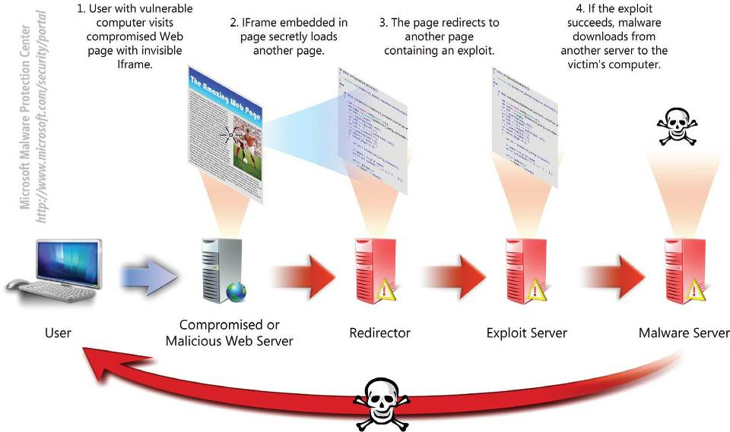
Drive-by Download
https://www.microsoft.com/security/sir/glossary/drive-by-download-sites.aspx

Slide 78

Karthikeyan Dhayalan
MD & Chief Security Partner
www.cyintegriti.com

